Slide 1

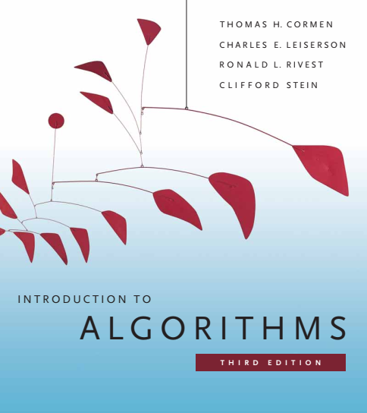
Design and Analysis of Algorithms
Dr. Sajid Iqbal
sajidiqbal.pk@gmail.com
Reference Book
Introduction to Algorithms 3rd Edition By Thomas H. Cormen et. al.
https://mitpress.mit.edu/books/introduction-algorithms-third-edition
COMEDXD

Slide 2
The Randomized Quick Sort
Application of Divide and conquer method

Slide 3
Background
Previously we have assumed that every permutation of input is equally likely
However our assumption may not hold
To get good average case performance over given input, we add randomization to algorithm
Randomized version of quick sort is usually choice for large sized inputs
Random Sampling: A method to randomize the input
Instead of always taking A[r] as the pivot
Choose an element randomly from the array A[p…r] to be pivot
Any element of the array could be pivot
This will increase the chances of good splits in the sort algorithm

Slide 4
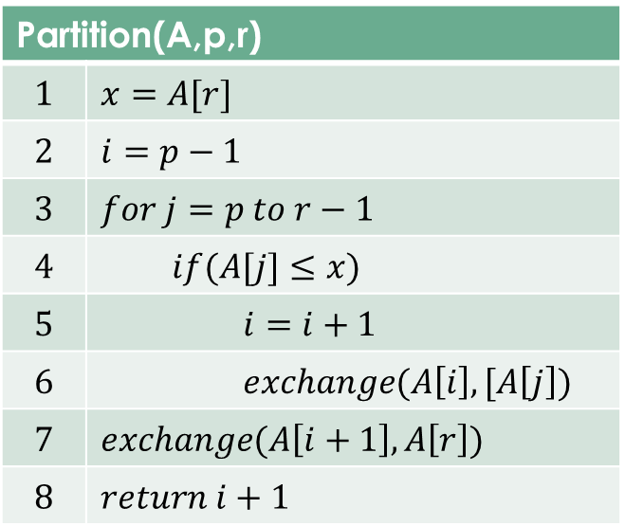
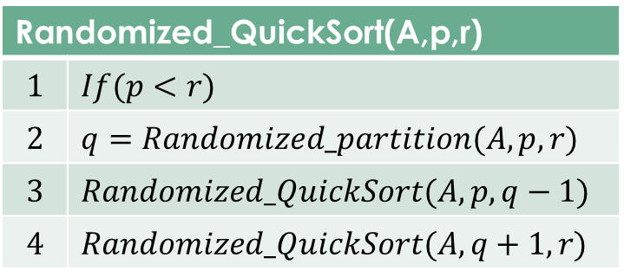
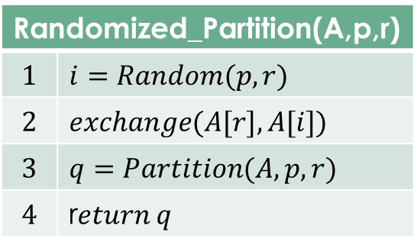
Randomized QS
The Partition method is same as before
Randomized partition selects the pivot element randomly
Rest of the process is same as before

Slide 5

Worst-case analysis
We saw that worst case running time of QS is $θ(n^{2})$
We prove it now
There may be good and bad splits so we can write
$T\left(n\right)=\max_{0≤q≤n−1}\left(T\left(q\right)+T\left(n−q−1\right)\right)+θ(n)$
$T\left(n\right)≤\max_{0≤q≤n−1}{(cq^{2}+c{\left(n−q−1\right)}^{2})+θ(n)}$
$T\left(n\right)≤c∗\max_{0≤q≤n−1}\left(q^{2}+{\left(n−q−1\right)}^{2}\right)+θ\left(n\right)$
$\max_{0≤q≤n−1}{(q^{2}+{\left(n−q−1\right)}^{2})}≤{\left(n−1\right)}^{2}=n^{2}−2n+1$
$T\left(n\right)≤cn^{2}−c2n+c∗1+θ(n)$
$T\left(n\right)≤cn^{2}+θ(n)$
$T\left(n\right)≤O(n^{2})$

Slide 6

Average case analysis
Randomization in QS creates more balanced partitions
No. of levels in recursion tree : $θ(logn)$
Cost to partition at each level: $O(n)$
So the total cost is: $O(nlog n)$

Slide 7
Python Implementation of QS
def Partition(A, p, r): x = A[r] i = p-1 for j in range(p, r): if A[j] <= x: i = i+1 A[i], A[j] = A[j], A[i] A[i+1], A[r] = A[r], A[i+1] return (i+1)
4
def Randomized_Partition(A,p,r): from random import randint i = randint(p, r) A[i],A[r]=A[r],A[i] q = Partition(A,p,r) return q
# Driver code A = [2, 8, 7, 1, 3, 5, 20, 4,10,9,6] p = 0 r = len(A) Randomized_Quick_Sort(A, p, r-1) print("Array after quick sort..:") print(A)
1
2
3
def Randomized_Quick_Sort(A, p, r): if p < r: q = Randomized_Partition(A, p, r) Randomized_Quick_Sort(A, p, q-1) Randomized_Quick_Sort(A, q+1, r)

Slide 8

Thanks for watching
Dr. Sajid Iqbal
Assistant Professor
Department of Computer Science
Bahauddin Zakariya University, Multan
sajidiqbal.pk@gmail.com
YouTube Channel: COMEDXD
Allah Hafiz

Slide 9

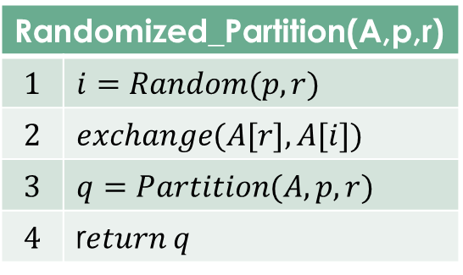
Randomized_QuickSort(A,p,r)
$$1$$ | $$If(p<r)$$
$$2$$ | $$q=Randomized_partition(A,p,r)$$
$$3$$ | $$Randomized_QuickSort(A,p,q−1)$$
$$4$$ | $$Randomized_QuickSort(A,q+1,r)$$
Randomized_Partition(A,p,r)
$$1$$ | $$i=Random(p,r)$$
$$2$$ | $$exchange(A[r],A[i])$$
$$3$$ | $$q=Partition(A,p,r)$$
$$4$$ | r$eturn q$

